Slide 1
PSC Interns 2018 Final Report Presentation: Building a Data Pipeline for Calima Dashboard
Date: 2018/08/04
Intern: Alice (Chia-Hua Lee)

Slide 2
Agenda
Motivation
Data Source
Data Pipeline
Data Preprocessing
Dashboard Demo
Benefit for the Center

Slide 3
Motivation
Deliver the right data to the right person
…
System Administrator
Director
Consultant
End User
Notes:
PSC offers a wide range of high-performing computational resources for the nationwide academic communities. Given the variations of the project scale and field, sometimes a specific type of resource is heavily used while others are idle. To alleviate the burden of heavily used ones and minimize the wait time for both batch and interactive jobs on Bridges, administrators run routine commands to get a sense of the real-time usage pattern and queue length. Decision makers also depend on these manually-ran query reports to monitor the overall machine utilization and decide on the necessity for center to purchase additional computational resources. Moreover, our clients, the users, and user account administrators also need to obtain actionable information about queues, account utilization, and system load at real time. This project aims to create an end to end pipeline to automate the process of delivering the right data to the right people. This presentation will discuss how Calima Dashboard project was implemented as well as how different stakeholders can benefit from this BI tool.

Slide 4
Data Source: Allocations
# | Table Name | Brief Description
1 | public.subgrant | grant info
2 | Public. subgrantplatinfo | platform info: Reg, GPU, Large,SU allocations
3 | public.subgrantmach | machine Reg, GPU, Large
4 | platmachuser | grant/platform/machine/username
5 | users | grant/platform/machine/username
6 | nsfaffiliations | affiliations table (eg. CMU, Pitt, MIT, etc..)
7 | public.jobs | subset of slurmdb focusing on jobs for accounting purposes
8 | public.prorated_jobs | Truncate jobs into daily basis
9 | Public.actions | new grant, renewal, supplement, time_extension, SU amount
Development Environment: bell
Production Environment: noll
Data History: 2016 /03 ~ 2018/8/4
Data Size: 8883,000+ rows
users | platmachuser | subgrant | subgrantmach | nsfaffiliations | jobs | prorated_jobs
pscid | subgrantnumber | subgrantnumber | chargeid | affilcode | job_id | job_id
firstname | machine | pipscid | machine | affiliation | machine | username
lastname | username | consultant | startdate | lat | walltime | machine
department |  | title | enddate | long | charge_id | charge_id
affilcode |  |  | allocation |  | partition | job_name
telephone |  |  |  |  | start_time | prorated_jobs
email |  |  |  |  | submit_time | short_date
country |  |  |  |  |  | start_time
 |  |  |  |  |  | prorated_su_charged

Slide 5

What is Allocations Data About?
PI
Affiliation: PSC
pipscid: Nystromp
Email: nick@psc.edu
Telephone: 412567983
Consultant
Subgrant Number
CDA090001P
MCB170031P
DMR160034P
RM 20000
Allocation
GPU 30000
RM 10000
RM 20000
LM 40000
Start - End
2017/07/08 -2019/04/04
Charge ID
pscstaff
mr5612p
ca8r6hp
Title
PSC Staff
Bridges Workshop
AI & BD Intern
UserID
User Name
JobID/SU charged/Machine

Slide 6
Analysis
Allocations
Machine Theoretical Utilization
Machine daily users & Jobs
Affiliation
Department Project & Users @ CMU, Upitt
Dashboard Link: http://rubber.bridges.psc.edu:5601/

Slide 7
Data Source: Slurm
# | Columns used for sacct | Columns used for sacctmgr
1 | Account | NodeName
2 | AllocTRES | TimeStart
3 | JobName | TimeEnd
4 | JobID | State
5 | User | User
6 | Partition
7 | Start
8 | State
9 | Submit
10 | ReqMem
11 | Timelimit
12 | NodeList
Development/Production Environment:
Get raw CSV File directly from sacct & sacctmgr
Data History:
*** only have sacctmgr data since June

Slide 8
What is sacct & sacctmgr Data About?
Partition : GPU
ReqTime: 2hr
Node: 4
NodeList: gpu[036,038-040]
Submit Time: 2017/08/01 13:00:02
Get Events on downed or draining nodes on clusters

Slide 9
Sacctmgr Data Size

Slide 10
Sacct Data Size

Slide 11
Analysis
GPU Utilization & Backlogs
EX: Run a GPU job on 4 P100 nodes for 30 minutes is
→interact -p GPU --gres=gpu:p100:2 -N 4 –t 30:00:00
RM Utilization & Backlogs
EX: Run in the RM-shared partition using 4 cores and 1 hour of walltime.
→interact -p RM-shared --ntasks-per-node=4 –t 1:00:00
→interact -p RM -N 2 -t 30:00
LM Utilization & Backlogs
EX: Run in the LM partition for 10 hours of wall time and 6TB of memory is:
→interact -p LM - t 10:00:00 --mem 6000GB
Dashboard Link: http://rubber.bridges.psc.edu:5601/

Slide 12
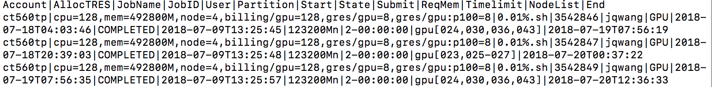
saact & sacctmgr Raw Data (How to take snapshot?)
Sample sacct command for GPU nodes:
sacct -a -P -X -S 071918-00:00:00 -E 072018-23:59:59 --format=Account,AllocTRES,JobName,JobID,User,Partition,Start,State,Submit,ReqMem,Timelimit,NodeList,End -s CANCELLED,TIMEOUT,FAILED,COMPLETED,NODE_FAIL,OUT_OF_MEMORY -r GPU,GPU-shared,GPU-small> today_gpu.csv
Sample sacctmgr command:¶
sacctmgr show events -P event=node Start=071918-00:00:00 End=072018-23:59:59 > today_state.csv

Slide 13
Calima Dashboard Data Pipeline
CSV files
Raw data
preprocess.py
Processed data
rubber.bridges.psc.edu
automate.sh
Execute command to extract data
Invoke python script to clean data
Copy the processed data to docker (inotifywait package)
Notes:
1. execute sacct/sacctmgr command every day → get log csv
2. Execute python script(data cleansing) by submitting batch jobs→get 9 new csv
3.Copy these files from local to docker
4. Logstash will ingest new data into Elasticsearch
5. New data will show on Kibana Dashboard with updated graphs

Slide 14
Logstash
Ruby

Slide 15
Elasticsearch under the hood - Lucene

Slide 16
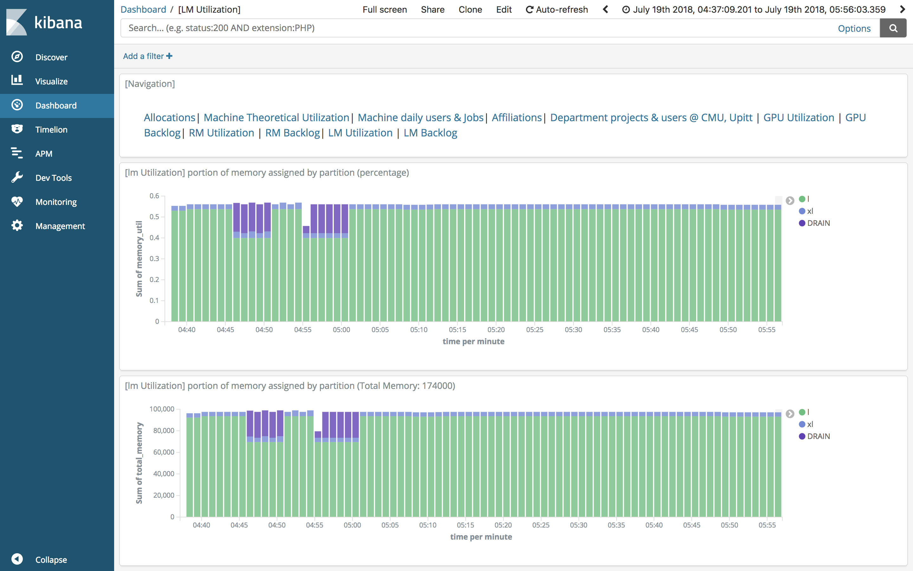
Kibana

Slide 17
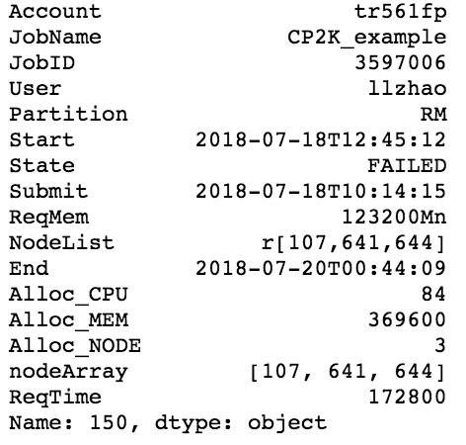
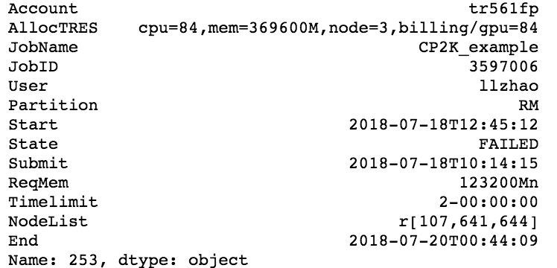
Data Preprocessing (1) – Job Transform
Take RM Node as an example
AllocTRES cpu=32,mem=123200M,node=1,billing/gpu=32,gres/gpu=2,gres/gpu:p100=2
NodeList r[ 107, 108-110, 131, 565]
NodeList l[ 003, 004-005, 009],xl[ 001, 002]

Slide 18
Data Preprocessing (2) - Time
(submit) (start)
Transform start and end time to minute per row (like taking snapshot)
If a job has a start time of 2018-07-19T13:28:35 and end time of 2018-07-19T13:32:21 in sacct, this single job will be converted to four rows with timestamp like the following:
2018-07-19T13:28:35
2018-07-19T13:32:21
2018-07-19
13:28:00
2018-07-19
13:29:00
2018-07-19
13:30:00
2018-07-19
13:31:00
2018-07-19
13:32:00
2018-07-19
13:33:00
A job that waits for 10 days to be executed would have 60*24*10= 14400 rows

Slide 19
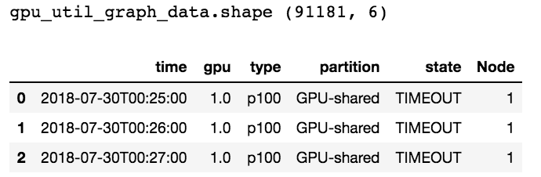
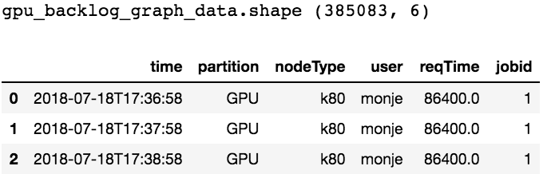
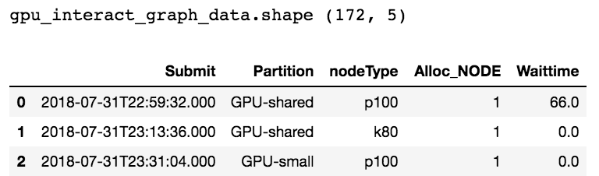
Preprocessed Data (August 1st –August 3rd )
GPU
Utilization
Backlog
Original
(2374, 18)
Interactive

Slide 20
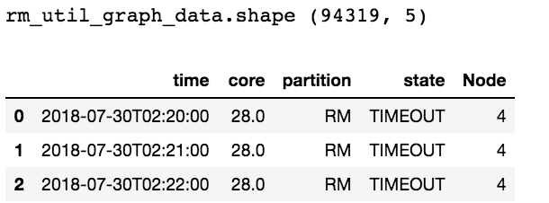
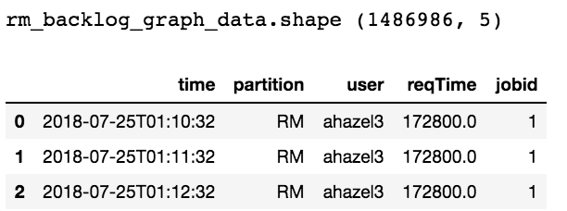
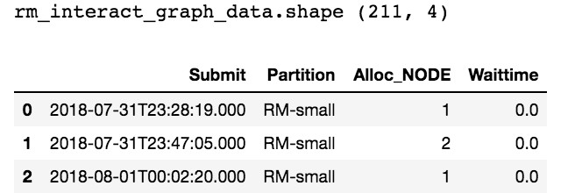
Preprocessed Data (August 1st –August 3rd )
RM
Utilization
Backlog
Original
(8306, 18)
Interactive

Slide 21
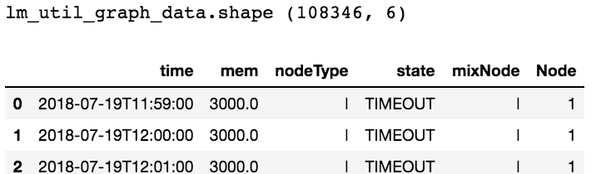
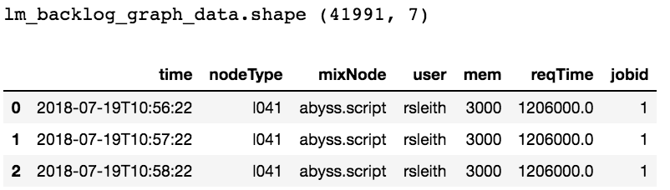
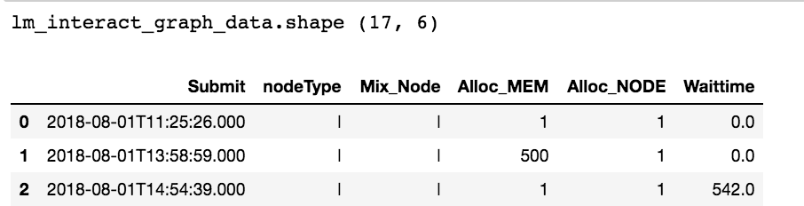
Preprocessed Data (August 1st –August 3rd )
LM
Utilization
Backlog
Original
(4170, 18)
Interactive

Slide 22
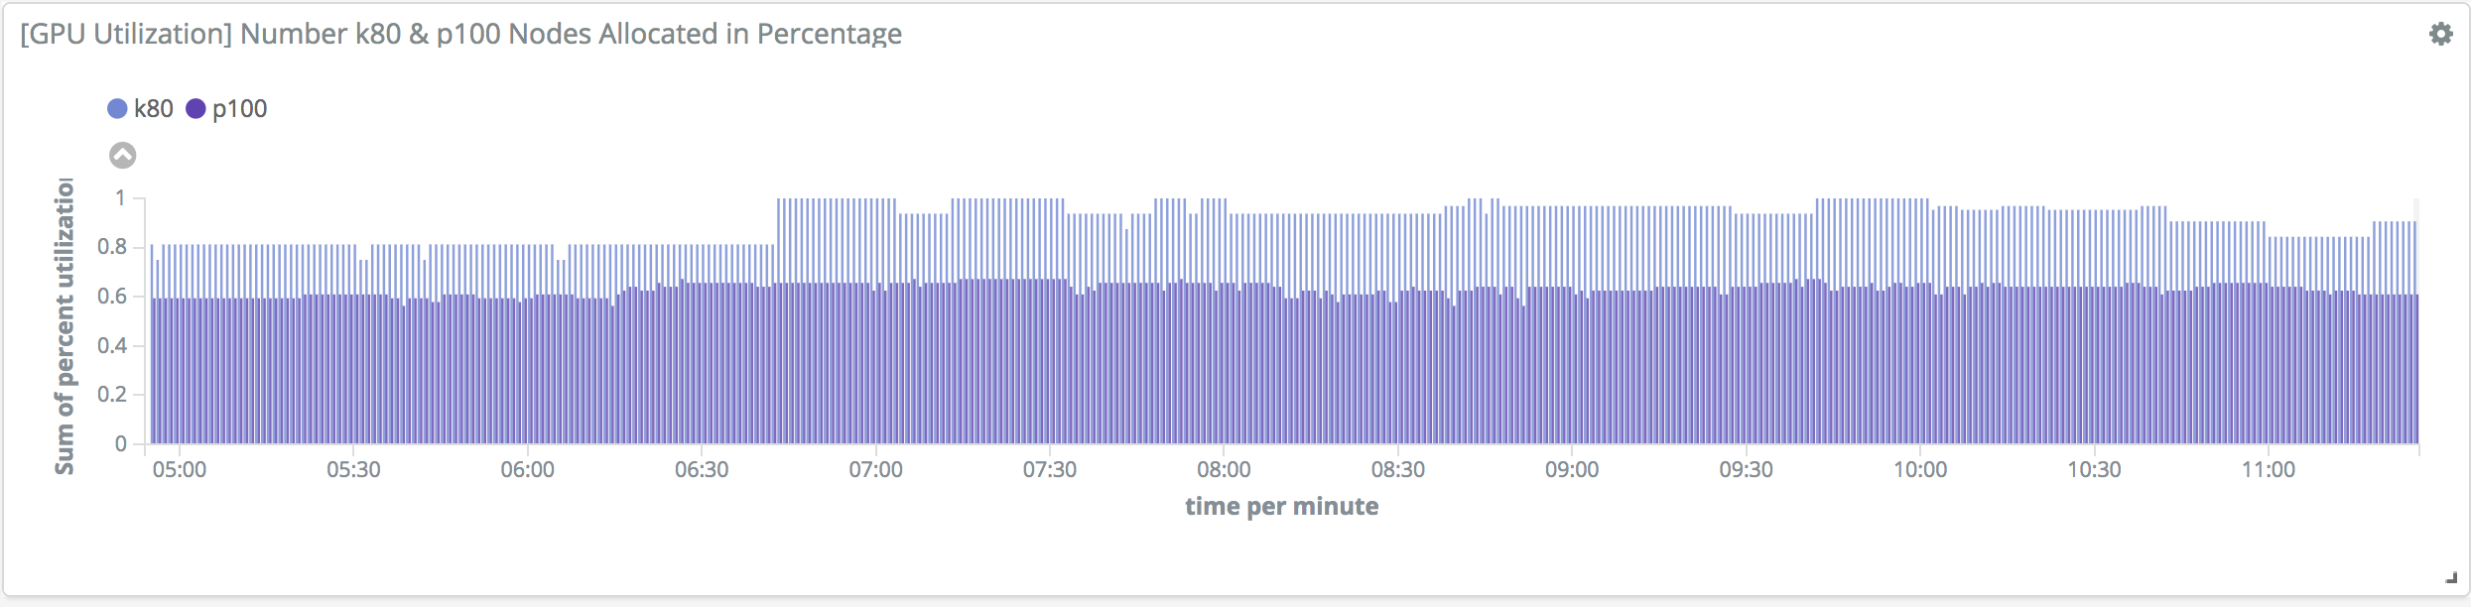
GPU Utilization

Slide 23
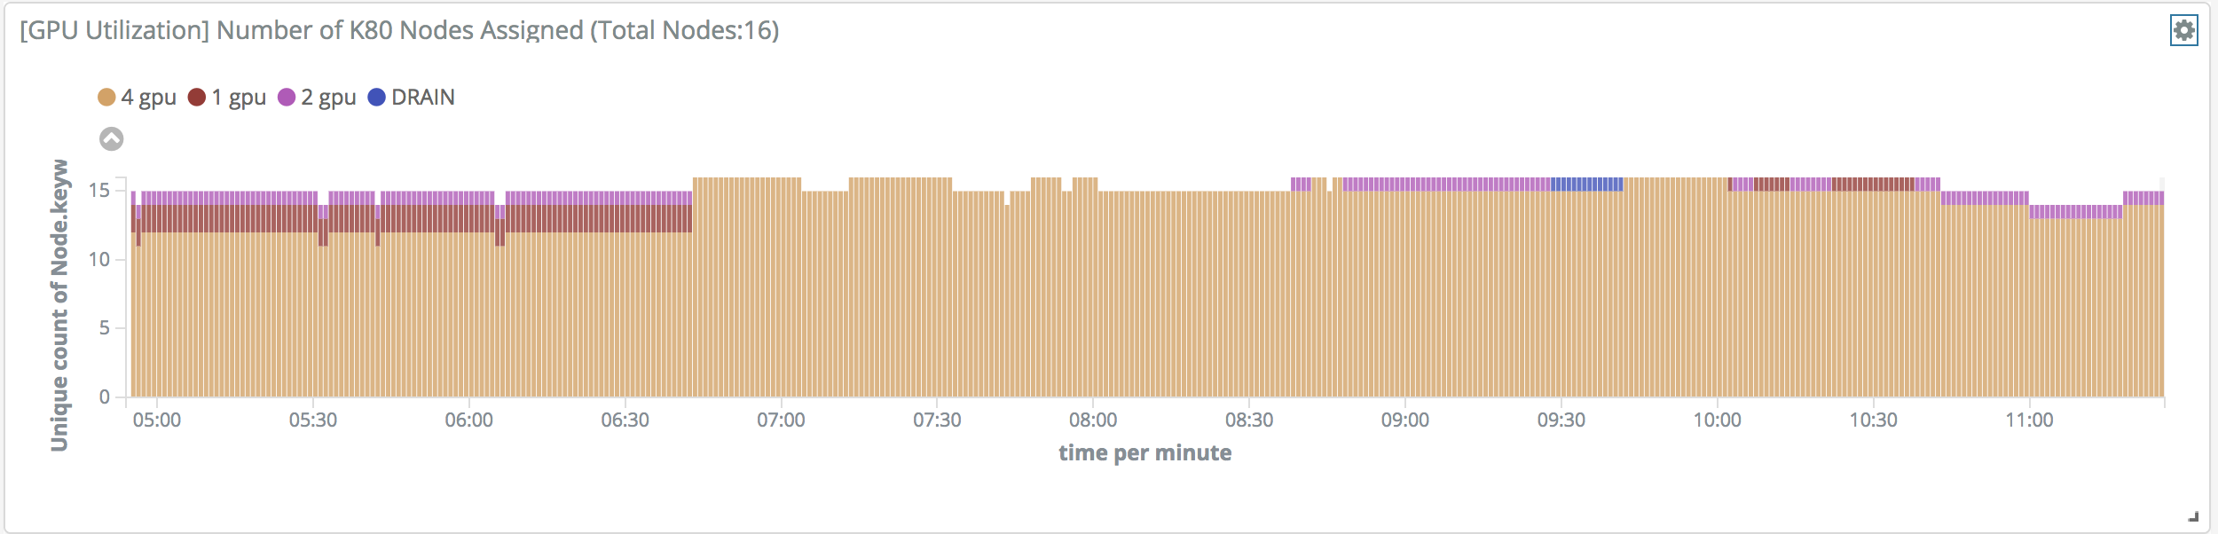
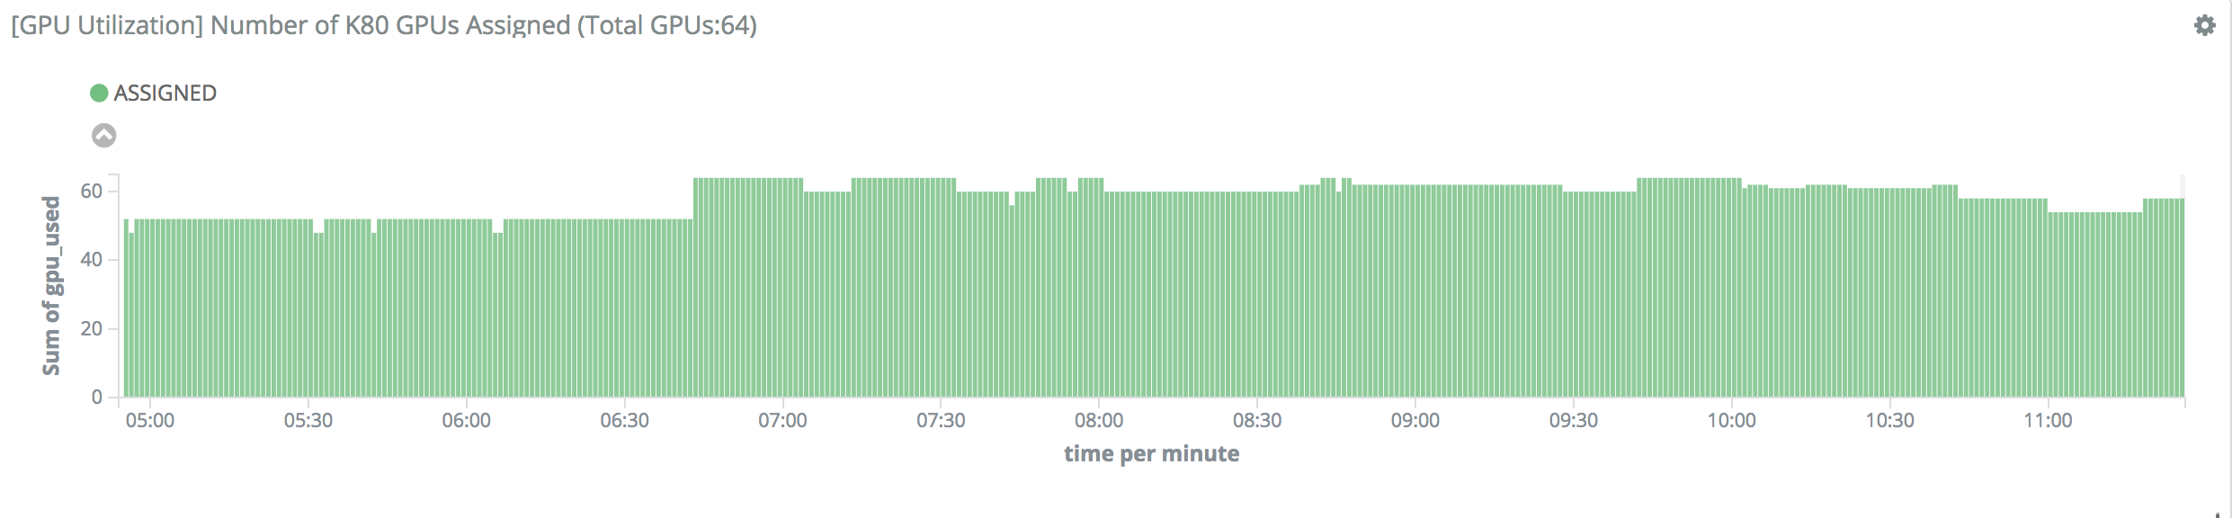
GPU Utilization

Slide 24
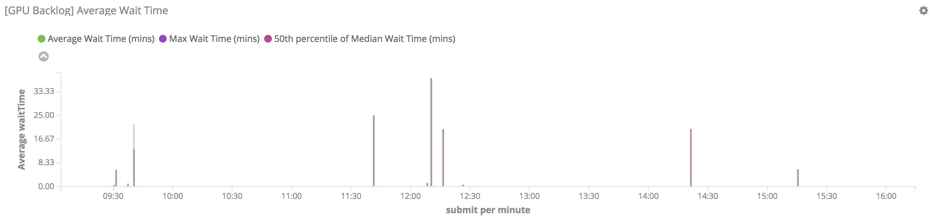
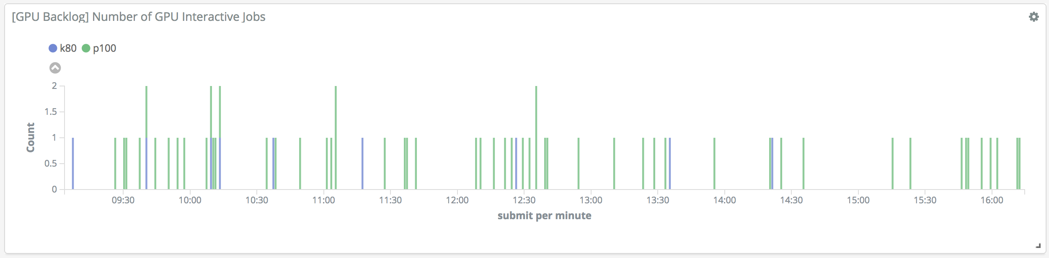
GPU Backlog

Slide 25
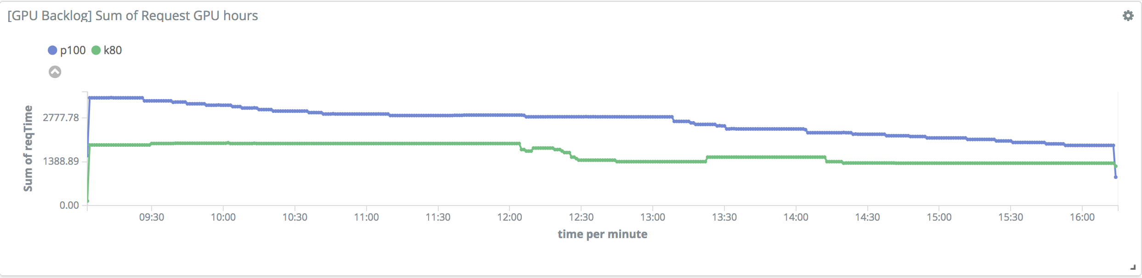
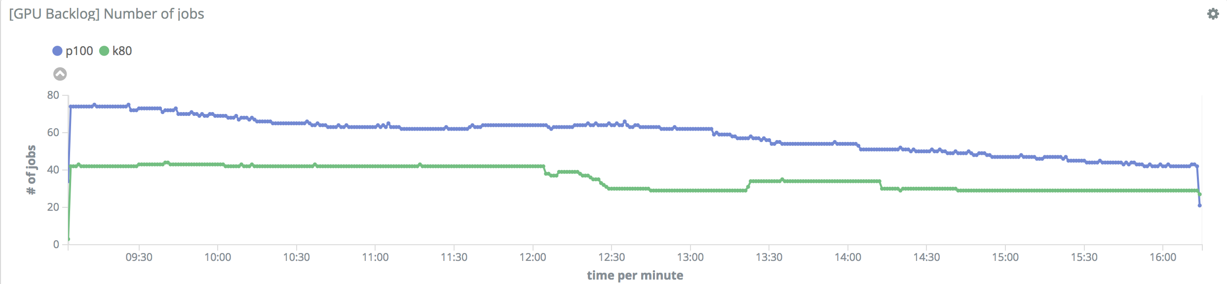
GPU Backlog

Slide 26
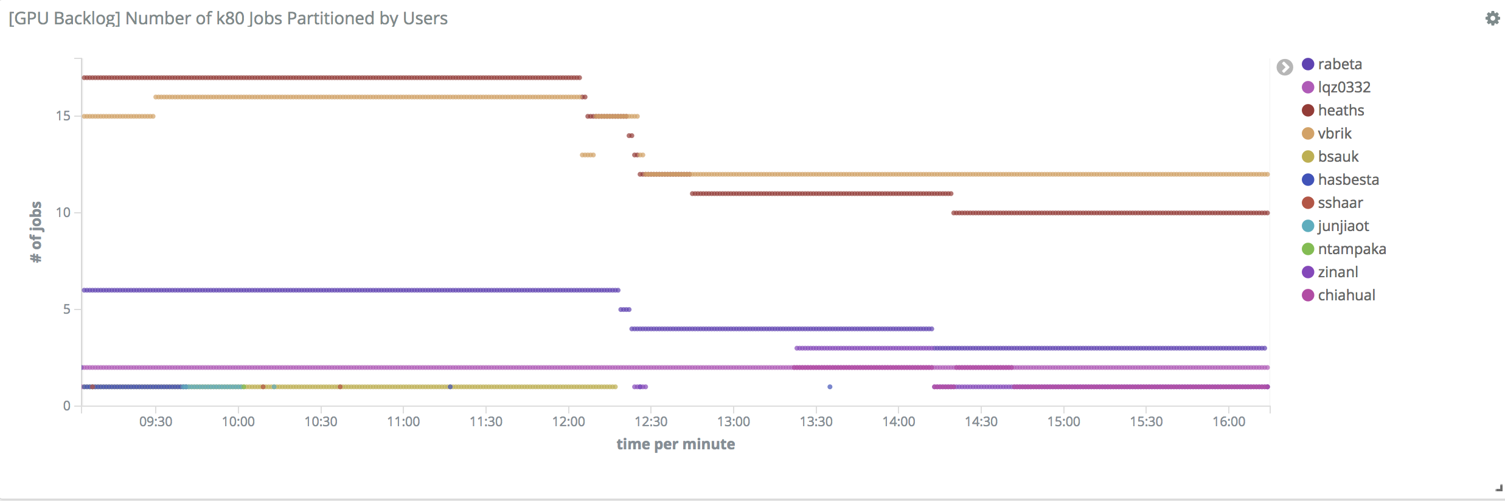
GPU Backlog

Slide 27
Benefit for the center

